Slide 1
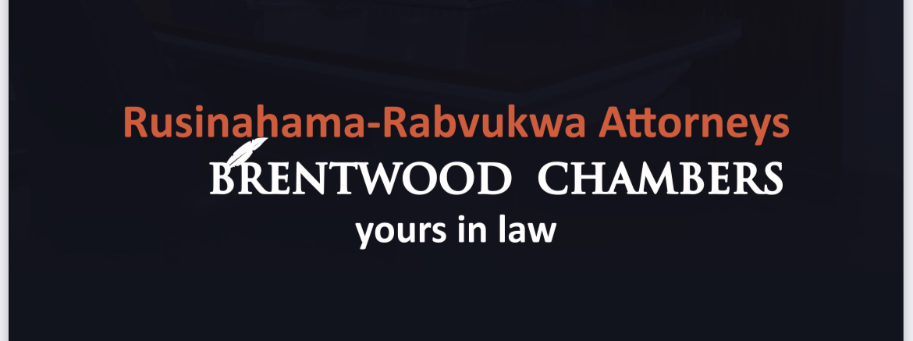
PROPERTY ACQUISITION AND ESTATE PLANNING

Slide 2
TENDAI RUSINAHAMA RABVUKWA
LLBS(Hons) UZ
Former Senior Magistrate
Founder and Senior Partner Brentwood Chambers
Happily Married to James Rabvukwa
263772743338, tendai@brentwoodchambers.com
www.brentwoodchambers.com

Slide 3
PROPERTY ACQUISITION GUIDANCE
If you want to acquire property, you better do it the right way. This part of the presentation outlines the steps a diligent property buyer must take before acquiring property.

Slide 4
1. WHAT IS DUE DILIGENCE?
Due Diligence is an investigative process on the nature of
property, its market value and the state of its title by a
prospective purchase in order to consider whether or not to
purchase.
STEPS
Visit the property
Title search - Check for encumbrances
Verification of identity of title holder of the seller
Market Research

Slide 5
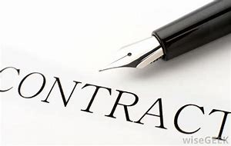
CONTRACT STAGE
Money should not exchange hands between seller and purchaser – use a trust account
Seller ought to receive purchase price only after transfer of title
Perform a due diligence on your lawyer

Slide 6
PROPERTY MANAGEMENT
Most people neglect their properties and in the process lose commercial value
RISK AREAS
Sahwira syndrome – signing away property as surety
Failure to maintain infrastructure
Carelessness with title deed

Slide 7
WHAT IF YOU DIE NOW? PSALM 89:48 “What man is he that liveth, and shall not see death? shall he deliver his soul from the hand of the grave? Selah”.

Slide 8
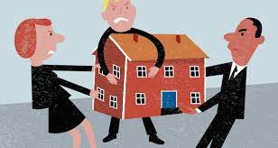
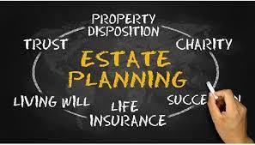
ESTATE PLANNING
WHAT HAPPENS TO YOUR PROPERTY WHEN YOU ARE GONE?

Slide 9
Why talk about Estate Planning
ISAIAH 38:1 “In those days Hezekiah became mortally ill. And Isaiah the prophet son of Amoz came to him and said to him, “Thus says the Lord, ‘Set your house in order, for you shall die and not live’”
Is your house in order?
Estate planning is biblical Leviticus 27:8-11
Knowledge is power Hosea 4:6, Isaiah 5:13
Know the available options for planning your estate

Slide 10
TWO TYPES OF DEATH
One is an organised death but the other is a disorganised and chaotic one, Which one is yours?
1. INTESTATE DEATH…..No will/no valid will
2. TESTATE DEATH………valid will

Slide 11
What to do upon death In Zim
Register with Registrar of births and deaths for a death certificate
Register Estate with the Master of the High Court/Magistrate within 14 days
Upon registration the responsible person should complete a death notice form and inventory form listing deceased’s assets
Convene an Edict meeting (where there is no will) to appoint an executor- neutral executor to be appointed where there is no consensus
Inheritance is governed by general law or customary law depending on type of marriage

Slide 12
FORMS OF ESTATE PLANNING
Purchasing property in the names of children
Purchasing property in the name of a company and owning shares in the company
Writing a will
Constituting a Family Trust

Slide 13
Intestate Succession
Intestate death refers to death where a person dies
without leaving a will.

Slide 14
Inheritance under general law?
See Deceased Estates Succession Act 6:02 (DESA)
Surviving Spouse inherits the matrimonial home and all household goods
Remaining property is divided between the children and surviving spouse
In the absence of children or spouse, parents and siblings will be beneficiaries

Slide 15
INHERITANCE UNDER CUSTOMARY LAW
In terms of Administration of Estates Amendment Act no. 6 of 1997
spouse, inherits the matrimonial home and household effects
In addition to the house, the spouse is entitled to half of the remaining property
The other half is shared among the children.
What if there are more than one surviving spouses?
more than one wife, each wife is entitled to the matrimonial home that they stayed in before the death of the husband and all the household goods in it
All the wives are entitled to a 1/3 of the estate
They have to share that 1/3 with the first wife getting a larger share the first wife gets 2/3 of the 1/3, the other wives have to share the remaining 1/3. the other 2/3 of the estate is given to children of the deceased.

Slide 16
TESTATE SUCCESSION
Testate death:
This is “organized death”
One dies leaving a VALID will and their wishes will be respected.

Slide 17
Commonly KnownPlanning Options
WILL
TRUST

Slide 18
WILL VS TRUST
Wills and trusts are both important estate-planning tools, but they differ in important ways.
A will becomes active only after one's death BUT a trust is active the day you create it, and a founder may list the distribution of assets before their death in it
wills must go through a legal process called probate, where an authorized court administrator examines them. This process can be lengthy and potentially contentious if will is contested BUT Trusts are not required to go through probate when the Founder dies, and they cannot be contested.
Trusts offer more control of assets, but they are more expensive, tedious to set up, and actively managed.

Slide 19
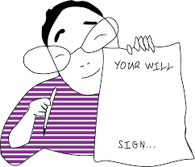
What is a will
WILLS ACT 6:06
A legal document (written, signed and witnessed) that indicates how one’s property will be distributed at the time of his death. It is revocable and subject to amendment at any time during one’s life time.
Within the will, the testator names an executor.
can be used to name a guardian for minor children as well as someone to handle the financial affairs of the children.
Will you write a Will?

Slide 20
Contents of a will
Designation of an executor, who carries out the provisions of the will.
Beneficiaries—those who are inheriting the assets.
Instructions for how and when the beneficiaries will receive the assets.
Guardians for any minor children.

Slide 21
Significance of will
Allows you to communicate your wishes clearly and precisely.
Ensures exact preferences will be followed upon your death.
Favour to loved ones.
Proverbs 13:22, Proverbs 19:14, 1Chronicles 28:8
It is used to fulfil the obligation to plan one’s estate: Isaiah 38:1,Genesis 48:21-22, Genesis 25:5
NB it is advisable to work closely with an attorney to create and update your will

Slide 22
FREEDOM OF TESTATION
As long as the property in question belongs to you, you are at liberty to bequeath it to anyone of your choice
The law even allows you to disinherit your SPOUSE and children etc (s5 (2) Wills Act)
But you cant prejudice rights of a creditor, co-owner or one with a court order over the property etc S 5(3) Wills Act

Slide 23
CAPACITY TO MAKE A WILL
S4 WILLS Act
16 YEARS OLD AND ABOVE
SOUND MIND

Slide 24
Requisite formalities
S8 of the wills Act
Writing
Signing
Attestation

Slide 25
Safe keeping
Registration with the Master’s office (you deposit it with the Master or Assistant Master)
Deposit with a Lawyer
Your Bank
Trusted friend ( In most cases only Jesus meets this criteria)

Slide 26
Grounds for challenging a Will
Lack of mental capacity
Undue influence
Improper execution of the Will
Fraud
Interpretation

Slide 27
What to do if nominated executor in a will
Apply for appointment to the master by providing the Master or the Assistant Master with:
the original Will and Codicils; and
death notice duly completed; and
preliminary inventory of assets; and
a letter indicating her/his willingness to be appointed; and
waiver letters from the beneficiaries waiving the need for the executor to provide security; and death certificate of the deceased; and
marriage certificate if the deceased was married; and
death certificate of the deceased’s spouse if the spouse died before; and
bond of security for the due and faithful administration of the estate.
The executor will be issued with Letters of Administration. These give the executor authority to wind up the estate

Slide 28
FAMILY TRUSTS

Slide 29
A TRUST
Is a private legal arrangement in which the ownership of someone’s assets (which might include stock shares, cash, real estate or even artworks) is transferred to a private fund, and held or managed by an individual (or group of individuals) for the benefit of the trust beneficiaries. Can be arranged in many ways and can specify exactly how and when the assets pass to the beneficiaries.
Provides lifetime and after-death property management. If you are serving as your own trustee, the trust instrument will provide for a successor upon your death or incapacity. Court intervention is not required.
If a person is disabled by accident or illness, the successor trustee can manage the trust property. As a result, the expense, publicity, and inconvenience of court-supervised distribution of your estate can be avoided

Slide 30
HOW TO FORM A TRUST IN ZIM
Appear before a NOTARY PUBLIC for the execution of a notarial deed of donation Trust
The Deed of Trust operates as a regulatory document for the operation of the Trust arrangement. It guides the trustees on:
how to manage the trust property;
The manner in which the Trust property is to benefit the beneficiaries;
the trust period and what should happen to property upon termination; etc
Once notarised, deed becomes a legally recognised document
Deed of Trust can be registered with the Registrar of deeds for filing and record purposes
It is permissible for a founder to be trustee and a beneficiary as long as there is evidence of trusteeship
You can found as many trusts as you want…there is no limit

Slide 31
MERITS OF A FAMILY TRUST
Hands over family’s assets to future generations
Protects the property from creditors
Keeps the property separate from matrimonial property
Tax benefits
Generates income
Not easily revocable or altered
Confidential

Slide 32
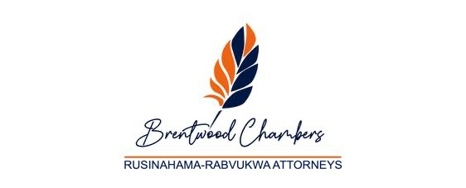
Thank you Mazvita Siyabonga Asante Sana
GOD BLESS YOU!!!!!

